Slide 1
Tampa Bay Android Developers Group
Build a Faster UI with ConstraintLayout
Notes:
Start with display of QR code (slide 108). Find your spot. Show time!
.
“Welcome everyone!” “Wow, we have a good-sized group in here.”
.
For this session, we’ll be talking about ConstraintLayout.
.
“We’ll go fairly quickly, so hopefully your after-lunch sleepiness won’t kick-in.”

Slide 2



About Me
Lead the
Help lead
Lead developer for
which does remote Android development and on-site training
Notes:
First, a quick blurb about me.
.
For fun, I’ve lead the TBADG on meetup for more than 6½ years,
.
and also help lead the Sun Coast Google Developer Group.
.
For work, I manage CF, which mostly caters to start-ups and other small clients.
.
We do remote Android dev and on-site training.

Slide 3
What is ContraintLayout?
Android's newest layout:
more flexibility
Notes:
So what is CL?
.
First, it’s Android newest layout,
and just went to production a few months ago.
.
It’s flexible, but has a few quirks and non-intuitive parts.

Slide 4
What is ContraintLayout?
Android's newest layout:
more flexibility
shallower view hierarchies
Notes:
Its primary benefit is to avoid lots of nested layouts and manual tweaking of positioning.

Slide 5
Requirements for Use?
Android 2.3 Gingerbread (API 9) or higher
Notes:
To use it, you must:
.
have at least API 9 / Gingerbread.

Slide 6
Requirements for Use?
Android 2.3 Gingerbread (API 9) or higher
Android Studio 2.2 or higher
Notes:
You’ll need to use AS 2.2 or higher.
.
But as always with AS, you’ll want to stay fairly current.

Slide 7
Requirements for Use?
Android 2.3 Gingerbread (API 9) or higher
Android Studio 2.2 or higher
Build tools 23.0.2 or higher
Notes:
You’ll want to use one the later version of the build tools.

Slide 8
Requirements for Use?
Android 2.3 Gingerbread (API 9) or higher
Android Studio 2.2 or higher
Build tools 23.0.2 or higher
Gradle dependency:
com.android.support.constraint:constraint-layout:1.0.2
Notes:
And you’ll also need to add a support lib dependency.

Slide 9
Requirements for Use?
Android 2.3 Gingerbread (API 9) or higher
Android Studio 2.2 or higher
Build tools 23.0.2 or higher
Gradle dependency:
com.android.support.constraint:constraint-layout:1.0.2
This talk uses Android Studio 3.0 Canary 5
Notes:
For this talk, we’ll use the latest Canary build.
.
This has some UI improvements that aren’t available in earlier versions, but the functionality is mostly equivalent.
.
For client work, I normally stick to the latest stable channel version.

Slide 10
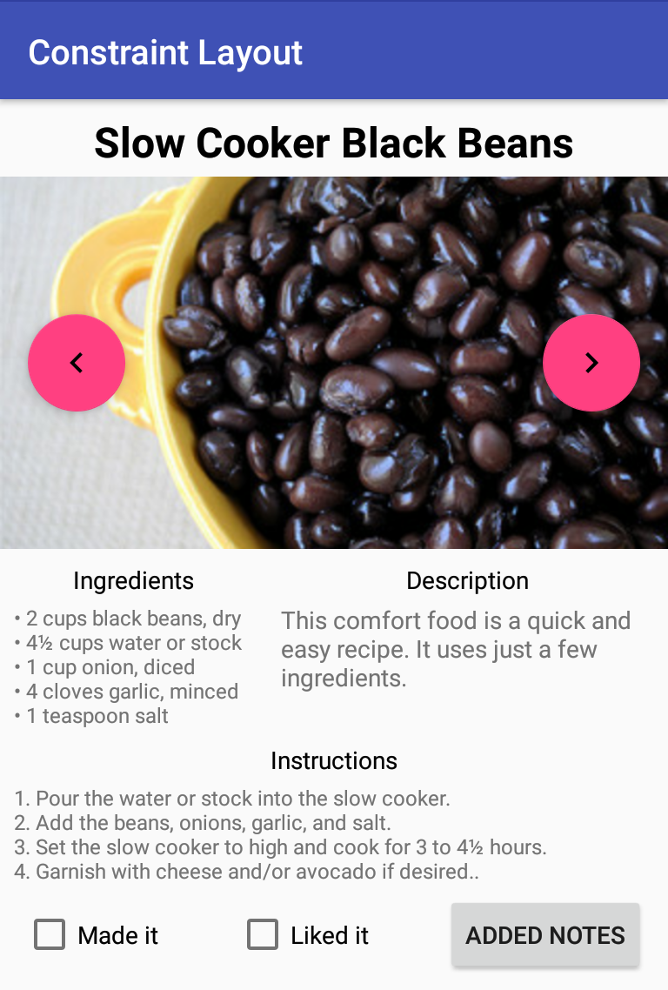
A Fairly Complicated Layout
* image from https://www.flickr.com/photos/cookbookman/5684475740
Notes:
Let’s consider an example layout.
.
It’s a bit contrived, but representative of what you may need to implement.
.
Note that there are:
. * Non-equal sub-columns
. * Overlayed nav buttons
. * That the Liked-it checkbox is evenly centered.

Slide 11
How to Create?
Notes:
How would we create it using the older layouts?
.
Use RL? Or LL? Or some nested combination?

Slide 12
How to Create?
Use RelativeLayout?
Notes:
Let’s consider RL.

Slide 13
How to Create?
Use RelativeLayout?
Trouble with:
40/60 column split
Notes:
We’d have trouble with the non-equal sub-column widths.

Slide 14
How to Create?
Use RelativeLayout?
Trouble with:
40/60 column split
Positioning Liked It
Notes:
Also, centering the Liked-it checkbox between the others would be troublesome.

Slide 15
How to Create?
Use LinearLayout?
Notes:
What about using a LL instead?

Slide 16
How to Create?
Use LinearLayout?
Trouble with:
Overlayed nav buttons
Notes:
LL doesn’t allow us to overlay views over others, so the navigation buttons would require something else.

Slide 17
How to Create?
Use LinearLayout?
Trouble with:
Overlayed nav buttons
Positioning Liked It still needs manual tweaking
Notes:
We’d still need some manual tweaking of margin, weight, and/or padding to position Liked-it correctly.

Slide 18
Old Style Layout
LinearLayout: vertical
TextView title
RelativeLayout
ImageView photo
FloatingActionButton prev
FloatingActionButton next
LinearLayout: horizontal, weighted
LinearLayout: vertical
TextView ingredients_lbl
TextView ingredients
LinearLayout: vertical
TextView description_lbl
TextView description
TextView instructions_lbl
TextView instructions
LinearLayout: horizontal
CheckBox made_it
CheckBox liked_it
Button notes
Notes:
With these issues, you’d have to use nested layouts.
.
This is a rather busy slide, so we’ll quickly explore it in pieces.

Slide 19
40/60 Column Split
LinearLayout: horizontal
LinearLayout: vertical with weight 40
TextView ingredients_lbl
TextView ingredients
LinearLayout: vertical with weight 60
TextView description_lbl
TextView description
Notes:
We could handle the non-equal sub-columns by-
.
wrapping them in a weighted LL row.

Slide 20
Overlayed Navigation Buttons
RelativeLayout
ImageView photo
FloatingActionButton prev
FloatingActionButton next
Notes:
The overlayed navigation buttons-
.
could be wrapped in a RL.

Slide 21
Positioning Liked It
LinearLayout: horizontal
CheckBox made_it
CheckBox liked_it with tweaked margins
Button notes
Notes:
Centering Liked-it could be done by wrapping the row of views in a LL and then manually tweaking the margins, padding or weights.
.
But what if the client or business unit changes the sizes of the buttons?
.
What about different languages? Might need different sized views.
.
In any case, you’d have a maintenance headache.

Slide 22
ConstraintLayout
Let's consider its layout components…
Notes:
Before seeing how to create the UI with CL, let’s look at its components.

Slide 23
Handles
– connection points used to specify constraints
Notes:
The handles are connections points for a view’s constraints.

Slide 24
Handle Types
resize – used to resize the view
Notes:
There are 3 types.
.
The 1st are resize handles.

Slide 25
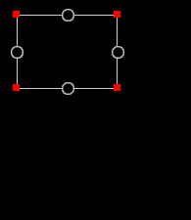
Handle Types
resize – used to resize the view
Notes:
These are shown as squares in the corners,
.
and work similarly to the way they do in most graphics tools.

Slide 26
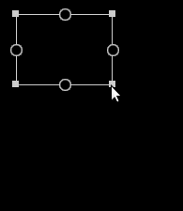
Handle Types
resize – used to resize the view
Notes:
You just click and drag.
.
Note that the width and height can be altered independently,
.
and are not locked together as in some other tools.

Slide 27
Handle Types
side – used for positioning and alignment
Notes:
The 2nd type are side handles.
.
These are used to define constraints that will be used to position and align the views.

Slide 28
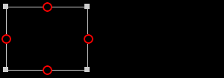
Handle Types
side – used for positioning and alignment
Notes:
These are shown as circles in the middle of each of the 4 sides.
.
Note that by “sides”,
.
we also mean top and bottom.

Slide 29
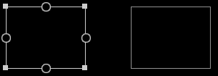
Handle Types
side – used for positioning and alignment
Notes:
To use these, you just click on one and drag to one on another view.

Slide 30
Handle Types
baseline – used for aligning text baselines
Notes:
The 3rd type are baseline handles.
.
These are used to horizontally align related text views such as labels and input fields.

Slide 31

Handle Types
baseline – used for aligning text baselines
(click to toggle handle visibility)
Notes:
You’ll need to first click the ab button to toggle them into view.

Slide 32

Handle Types
baseline – used for aligning text baselines
(click to toggle handle visibility)
Notes:
They’re each shown as a long horizontal oval inside their view.

Slide 33

Handle Types
baseline – used for aligning text baselines
(click to toggle handle visibility)
Notes:
Just like the side handles, you click on one and drag to one on another view.
.
Note that side handles and baseline handles are collectively called anchor handles.

Slide 34
Handle Rules
Can't mix handle types (side vs. baseline)
Notes:
A couple of rules that you must follow are:
.
1 – You can’t mix types.
.
You can only connect sides-to-sides, and baselines-to-baselines.

Slide 35
Handle Rules
Can't mix handle types (side vs. baseline)
Can't mix directions (vertical vs horizontal)
Notes:
2 – You can’t mix directions.
.
It really doesn't make sense to link the top of something with the side of something else.

Slide 36
Constraints
– rules used to size and position views
Notes:
The eponymous constraint components are of course where the magic happens!
.
They’re used to size views and position them in relation to each other and their parents.

Slide 37
Working with Constraints
To create:
(Select a view if its handles aren't visible)
Notes:
To create one, first select a view to show its handles.

Slide 38
Working with Constraints
To create:
(Select a view if its handles aren't visible)
Click on an anchor handle and drag to a second anchor handle
Notes:
Then click on one of its anchor handles and drag to one on another view.
.
Remember that the anchor handles are the side and baseline handles.
.
You can also create a constraint to the edge of a view’s parent view or a guideline.

Slide 39
Working with Constraints
To create:
(Select a view if its handles aren't visible)
Click on an anchor handle and drag to a second anchor handle
Notes:
Then click on one of its anchor handles and drag to one on another view.
.
Remember that the anchor handles are the side and baseline handles.
.
You can also create a constraint to the edge of a view’s parent view or a guideline.

Slide 40
Working with Constraints
To delete:
Click on an anchor handle to delete
its attached constraints
Notes:
Clicking on either end of a constraint will delete it.

Slide 41

Working with Constraints
To delete:
Click on an anchor handle to delete
its attached constraints
Click on to delete all constraints
for a view
Notes:
Clicking on the x-looking button will delete all of a view’s constraints.

Slide 42
Chains
– used to divvy up space between views
Notes:
Another useful component type is the chain.
.
Chains used to easily distribute the space around a set of views in a row or column.

Slide 43
Working with Chains
To create:
Add bidirectional constraints
Notes:
To create one, you can add constraints in both directions for all of the views in the group.
.
So view 1 to view 2, both directions,
.
and view 2 to 3 both directions, and so on.
.
This is how you have to do it in older versions of AS.

Slide 44


Working with Chains
To create:
Add bidirectional constraints
Or select (Create Horizontal Chain)
or (Create Vertical Chain)
Notes:
It’s much easier in later versions.
.
Just select the group of views and click on one the Create Chain toolbar items.

Slide 45
Working with Chains
Represented in XML as a pair of constraints
Notes:
Note that each link in the chain is represented in the XML as a pair of bidirectional constraints.
.
There isn’t a special chain attribute (yet).

Slide 46

Working with Chains
Represented in XML as a pair of constraints
Click on to cycle through chain modes
Notes:
There are 3 different chaining modes.
.
Click on the chain button to cycle though them.

Slide 47
Chain Modes
spread – evenly distribute available space
Notes:
The 1st mode is called spread.
.
This evenly distributes the space between the views and the edges of the parent.

Slide 48
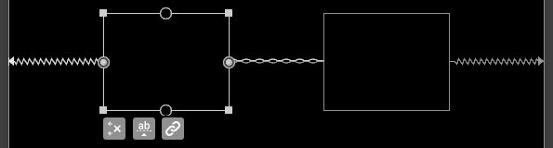
Chain Modes
spread – evenly distribute available space
Notes:
While we’ll just look at horizontal chains,
.
remember that they can also be vertical.

Slide 49
Chain Modes
spread_inside – also move outer views to edges
Notes:
The 2nd mode is called chain_inside.
.
This also distributes the space evenly amongst the views,

Slide 50
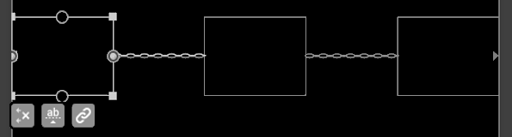
Chain Modes
spread_inside – also move outer views to edges
Notes:
but it first moves the outside pair of views to to the edges of the parent.

Slide 51
Chain Modes
packed – pack views together
Notes:
The 3rd mode is called packed.
.
It moves all the views together,

Slide 52
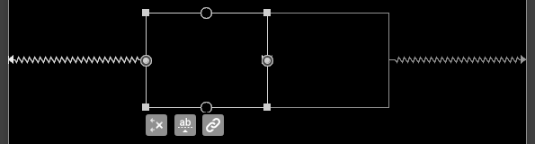
Chain Modes
packed – pack views together
Notes:
then evenly distributes the space between the outer views,
.
and the edges of the parent.

Slide 53
More Chain Info
Margins can be added and will be honored
Notes:
When using chains,
.
note that view margins will be honored.
.
For instance, packed mode may still put some space between the views.
.
And the outer views of spread_inside might have some space outside them.

Slide 54
More Chain Info
Margins can be added and will be honored
Spread modes can use weights
Notes:
The spread modes can also use weights,
.
which can be used to mimic weights as used with LL.

Slide 55
More Chain Info
Margins can be added and will be honored
Spread modes can use weights
Packed mode can use bias
Notes:
Also, packed mode can use bias,
.
which can be used to position the group of views off-center,
.
with uneven spacing on the sides.
.
We’ll revisit using bias in a bit.

Slide 56
Guidelines
– design-time visual guides used for alignment
Notes:
Another type of component is the guideline.
.
Guidelines are used for aligning views.
.
While their position is used at runtime,
.
they’re only visible during design time.

Slide 57
Guideline Info
Used to implement Material Design keylines
Notes:
These allow the implementation of keylines as defined in the Material Design Guidelines.

Slide 58
Guideline Info
Used to implement Material Design keylines
Used as constraint anchor points
Notes:
They function as alternate anchors.

Slide 59
Guideline Info
Used to implement Material Design keylines
Used as constraint anchor points
Click on to create
Notes:
To create one,
.
select one of the Add Horizontal Guideline or Add Vertical Guideline toolbar items.

Slide 60
Guideline Types
begin – number of pixels from the left/top
Notes:
There are come in 3 types,
.
which mostly differ in the way they are specified.
.
The 1st is begin.

Slide 61
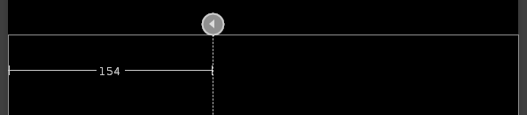
Guideline Types
begin – number of pixels from the left/top
Notes:
Its indicator is a left or up arrow,
.
And is specified as the number of pixels from the beginning (left/top).

Slide 62
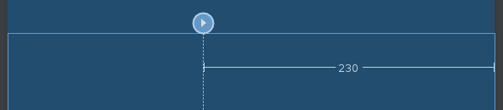
Guideline Types
end – number of pixels from the right/bottom
Notes:
The 2nd type is end,
.
whose indicator is a right/down arrow.

Slide 63
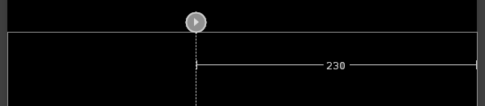
Guideline Types
end – number of pixels from the right/bottom
Notes:
And is specified as the number of pixels from the end (right/bottom).

Slide 64
Guideline Types
percent – percentage from the left/top
Notes:
The 3rd type is percent,
.
whose indicator is a % sign.

Slide 65
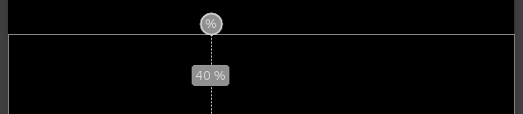
Guideline Types
percent – percentage from the left/top
Notes:
This one’s position is specified as the percentage of the parent’s size from the beginning
(left/top).

Slide 66
Moving Guideline Position
Click on guideline line and release
Notes:
To set a guideline’s position,
.
first select a guideline by clicking and releasing-
.
its line, not its type indicator.
.
By releasing it after selecting it, it will continue to display its position as you move it.

Slide 67
Moving Guideline Position
Click on guideline line and release
Click on line again and drag
Notes:
To do the actual move, click on the line again and drag to desired position.

Slide 68
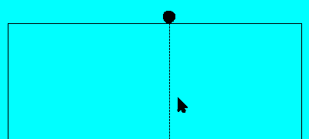
Moving Guideline Position
Click on guideline line and release
Click on line again and drag
Notes:
If you did click, release, click, move sequence,
.
its changing position will be displayed throughout the move.

Slide 69
Connecting to Guideline
Click on a view’s anchor handle and drag to a guideline
Notes:
You can constrain to a guideline just like any other view.

Slide 70
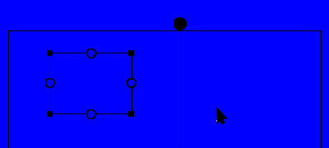
Connecting to Guideline
Click on a view’s anchor handle and drag to a guideline
Notes:
Click on an anchor and drag to the guideline’s line.

Slide 71
Layout Editor Views
Familiar text view with preview
Notes:
Let’s now consider the layout editor.
.
There are 2 main CL views.
.
The 1st is the familiar XML text view with a graphical preview.

Slide 72
Layout Editor Views
Familiar text view with preview
Design view with several panels
Notes:
The 2nd is a design view with some additions.

Slide 73
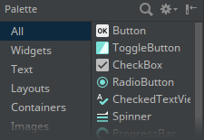
Design View Panels
Palette – categorized list of available widgets
Notes:
Looking at its panels,
.
there’s is a familiar looking palette of available view types.

Slide 74
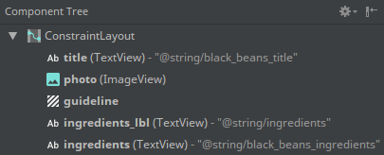
Design View Panels
Component Tree – currently defined views
Notes:
And a familiar looking component tree.
.
You may find this panel useful if you lose track of any of your views,
.
which is unfortunately quite easy to do while adding constraints.

Slide 75
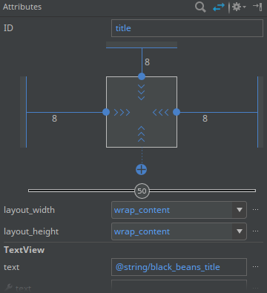
Design View Panels
Attributes – view inspector and properties
Notes:
Ah, but the property panel-
.
has a new name – Attributes.
.
.And an added part on top,
.
which I call it the Inspector graph.

Slide 76
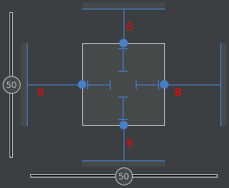
Inspector Graph Elements
Numbers outside box are margins
Notes:
In the inspector graph,
.
the numbers are the view’s margins.

Slide 77
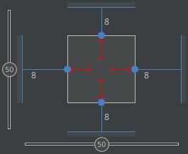
Inspector Graph Elements
Size: fixed
Notes:
Inside the box are some graphical indicators.
.
These specify the view’s size constraints.
.
Fixed-sized is indicated with straight bars.

Slide 78
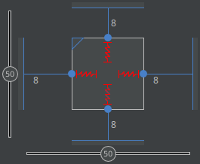
Inspector Graph Elements
Size: match_constraint
Notes:
match_constraint is indicated with saw-tooth shaped bars.
.
This type works like match_parent if the views is constrained to its parent.
.
In the XML, you might also see this shown as 0dp.

Slide 79
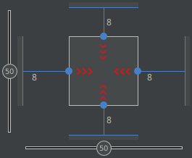
Inspector Graph Elements
Size: wrap_content
Notes:
The last size type is wrap_content,
.
which is indicated with chevrons.

Slide 80
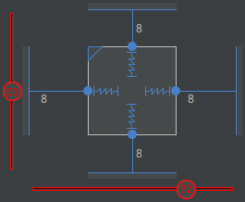
Inspector Graph Elements
Bias
Notes:
Finishing out the inspector graph,
.
the double-lines with circles allow us to specify a bias,
.
or offset centering.
.
In this case, the view will be centered vertically,
.
but be positioned 72% from the left.

Slide 81
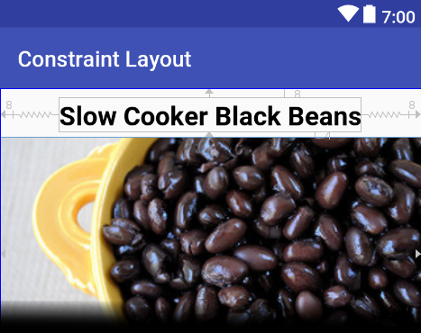
Design View Panels
Design – mostly WYSIWYG version of layout
Notes:
The main panel of the design view contains a representation of the layout.
.
The design representation is a mostly WYSIWYG rendering of the view.

Slide 82
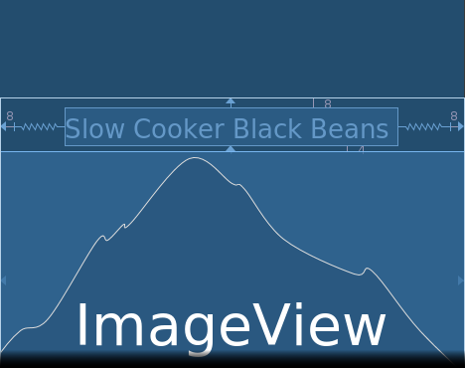
Design View Panels
Blueprint – architectural version of layout
Notes:
The blueprint representation is a simplified, architectural rendering of the view.

Slide 83
Toolbar Items
Click on:
to select layout versions to display
Notes:
This panel also has some new toolbar items.
.
These 3 items are used to select which representations are displayed.
.
In particular, they show the design, blueprint, or both representations.

Slide 84
Toolbar Items
Click on:
to select layout versions to display
to show/hide constraints/margins
Notes:
This item is used to-
.
select some display options.
.
Its most commonly used sub-item-
.
is used to show/hide the constraint indicators, which can get quite busy-looking.

Slide 85
Toolbar Items
Click on:
to select layout versions to display
to show/hide constraints/margins
to toggle autoconnect mode
Notes:
This one is used to-
.
toggle autoconnect mode,
.
which will be described later.

Slide 86
Toolbar Items
Click on:
to select layout versions to display
to show/hide constraints/margins
to toggle autoconnect mode
to delete ALL constraints
Notes:
And this one is used to-
.
delete all the constraints on all the views.
.
But be careful, there’s no confirmation prompt!

Slide 87
Toolbar Items
Click on:
to infer constraints for selected view
Notes:
This item is used to-
.
add inferred constraints,
.
which will also be described later.

Slide 88
Toolbar Items
Click on:
to infer constraints for selected view
to set defaults margins
Notes:
An item shown as a number is the default margin to use-
.
when constraints are added.

Slide 89
Toolbar Items
Click on:
to infer constraints for selected view
to set defaults margins
to distribute or size views
Notes:
This one is used to-
.
distribute or size views.
.
In particular, its sub-items allow for-
.
packing or unpacking-
.
or evenly distributing groups of views.

Slide 90
Toolbar Items
Click on:
to infer constraints for selected view
to set defaults margins
to distribute or size views
to align or center views (or create chains)
Notes:
This last item is used to-
.
position views.
.
Its sub-items allow for-
.
aligning groups of views by edges or centers,
.
centering views, or creating chains.

Slide 91
Autoconnect and Infer Constraints
Autoconnect mode adds constraints between an added / moved view and its neighbors
Notes:
As promised, we’ll briefly consider autoconnect and infer constraints.
.
First, autoconnect is a mode.
.
It causes constraints to be automatically added or updated for any manually moved view.
.
But only that view.

Slide 92
Autoconnect and Infer Constraints
Autoconnect mode adds constraints between an added / moved view and its neighbors
Infer Constraints action adds constraints for
all the views in the layout when it is clicked
Notes:
In contrast,
.
Infer Constraints is an action button that immediately adds constraints to all the views.

Slide 93
Dimension Ratio
Allows views to have explicit aspect ratio
Notes:
Let’s talk about a couple of CL features.
.
Dimension ratio allows for giving views explicit aspect ratios,
.
perhaps square,
.
w/o needing programmatic intervention.

Slide 94
Dimension Ratio
Allows views to have explicit aspect ratio
Set one dimension explicitly & other to “0dp”
Notes:
To use,
.
first set one dimension explicitly,
.
and the other to 0dp-
.
(like what is done for weighted LLs).

Slide 95
Dimension Ratio
Allows views to have explicit aspect ratio
Set one dimension explicitly & other to “0dp”
Ratio of width to height can then be specified
Notes:
An aspect ratio of width to height can then be specified.

Slide 96
Dimension Ratio
Manually add layout_constraintDimensionRatio to get ratio input will appear in the Inspector
Notes:
It seems like a oversight,
.
but the manual addition of an attribute is required-
.
to get a ratio input to appear in the inspector graph.
.
It can be added either via the attribute list or via XML.

Slide 97
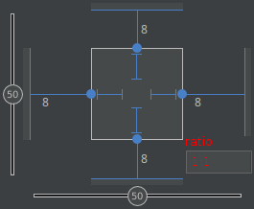
Dimension Ratio
Manually add layout_constraintDimensionRatio to get ratio input will appear in the Inspector
Notes:
So add this attribute; it’s particular value doesn’t matter.
.
And once that’s done,
.
an input box appears in the inspector graph.
.
The width to height aspect ratio is entered using a colon.

Slide 98
Replicating LinearLayout
As views are added, add constraints from their top/left to bottom/right of the previous view.
Notes:
Let’s consider how to replicate older-style layouts.
.
For LL, just add the views in order and add a constraint to each previous one.

Slide 99
Replicating LinearLayout
As views are added, add constraints from their top/left to bottom/right of the previous view.
Use weighted chains to replicate weights
Notes:
The layout_constraintHorizontal_weight attribute can be used to specify a horizontal weight,
.
while layout_constraintVertical_weight can be used for a vertical one.

Slide 100
Replicating RelativeLayout
Use equivalent constraints instead of relative attributes such as layout_ToStartOf
Notes:
For RR,
.
replace each of its relative positioning attributes-
.
such as ToStartOf, etc. with an equivalent constraint type.
.
There are many of these, such as
.
layout_constraintStart_toEndOf &
layout_constraintTop_toTopOf.

Slide 101
Replicating RelativeLayout
Use equivalent constraints instead of relative attributes such as layout_ToStartOf
For a full list of equivalents, see chart at
constraintlayout.github.io/layouts/relativelayout.html
Notes:
To select these,
.
You can use code completion.
.
Or you can find a complete list on the page shown here.
.
I’ll show this link again at the end of the presentation.

Slide 102
Replicating RelativeLayout
Use equivalent constraints instead of relative attributes such as layout_ToStartOf
For a full list of equivalents, see chart at
constraintlayout.github.io/layouts/relativelayout.html
Constrain to opposite sides to replicate centerHorizontal / Vertical or centerInParent
Notes:
To center a view, constrain to the opposite sides of the parent.
.
Remember in this context,
.
that sides also means top/bottom.

Slide 103
Replicating PercentLayout
Use percent-type guidelines for positioning
Notes:
PercentLayout only exists in the in support library,
.
but may be one you;re using.
.
To replicate,
.
it’s probably easiest to just use %-type guidelines.

Slide 104
Replicating PercentLayout
Use percent-type guidelines for positioning
Use aspect ratio (constraintDimensionRatio) for sizing
Notes:
The constrainDimensionRatio attribute-
.
that we saw a little while ago-
.
can be used to handle its aspect ratio sizing of views.

Slide 105
Some Pitfalls
Aspect Ratio doesn't appear in Inspector window until after being added manually
Notes:
So what are some of the pitfalls that I’ve encountered when using/designing CLs?
.
As stated earlier,
.
the constrainDimensionRatio attribute-
.
has to be manually added before the AR input box shows in the inspector.

Slide 106
Some Pitfalls
Aspect Ratio doesn't appear in Inspector window until after being added to XML
Grab guidelines by their lines, not indicator
Notes:
And guidelines are moved using their lines, not their type-indicators.
.
I’ve also found that-
.
selecting the line can be a bit tricky.
.
Doing an extra click near the line it seems to help.

Slide 107
Some Pitfalls
Aspect Ratio doesn't appear in Inspector window until after being added to XML
Grab guidelines by their lines, not indicator
Guidelines might not appear when first added until the layout is clicked
Notes:
Added guidelines don’t actually appear until you click inside the layout.

Slide 108
Some Pitfalls
Sometimes hard to see constraints if views or margins are small
Notes:
As constraints are added,
.
views sometimes get too small to see.
.
Or get lost in the clutter.
.
The Component Tree can be used to select them.

Slide 109
Some Pitfalls
Sometimes hard to see constraints if views or margins are small
Sometimes helpful to start with view dimensions set to absolute values
Notes:
At times, I’ve found it helpful-
.
to set a view’s initial size using some absolute values.
.
These will get overwritten when the view’s constraints are added.

Slide 110

Let's Create the Complicated Layout
The code is at:
github.com/sathisse/ConstraintLayout-Talk
Notes:
Now that we’ve explored some of
theory,
.
let’s actually create our complicated layout using CL.
.
A project with the layout supplied in several stages can be found at this URL.
.
.
After demo:
55:00

Slide 111
References
Google. “ConstraintLayout.” Android Developers, developer.android.com/reference/android/support/constraint/ConstraintLayout.html.
Accessed June 5, 2017.
Google. “Using ConstraintLayout to design your views.” Google Developers,
codelabs.developers.google.com/codelabs/constraint-layout. Accessed June 5, 2017.
Google. “What's New in Android Design Tools - New Features for Rapid UI Development (Google I/O '17).” YouTube, uploaded May 18, 2017,
www.youtube.com/watch?v=nYb4FUdlLZE.
Hugo, Huyen, Mark, Seb, Taylor, Wiebe, and Wolfram. “ConstraintLayout.” ConstraintLayout.com, constraintlayout.com. Accessed June 5, 2017.
Thisse, Scott. “ConstraintLayout-Talk”. GitHub,
github.com/sathisse/ConstraintLayout-Talk. Accessed June 15, 2017.
Notes:
I highly recommend checking these out, especially #2.
.
(if time) I’ll put this slide back up

Slide 112
Q & A
Questions?
Notes:
If time is short, offer to wait outside in the hallway
.
Otherwise, show previous slide until the end

